Slide 1





Become
A Member
Empower Gender Equality & Inclusive Culture in your Organisation
Copyright © 2025 FINANCY® Pty Ltd. The Financy Women’s Index™. All Rights Reserved.

Slide 2
Activate your Commitment!
This Membership is for leaders turning gender equity & inclusion plans into measurable progress. We support our members in moving beyond the talk and tickboxes by providing the tools, strategy and communications platform to build an authentic reputation from it.

Slide 3

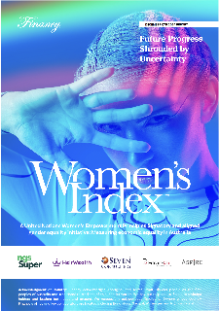
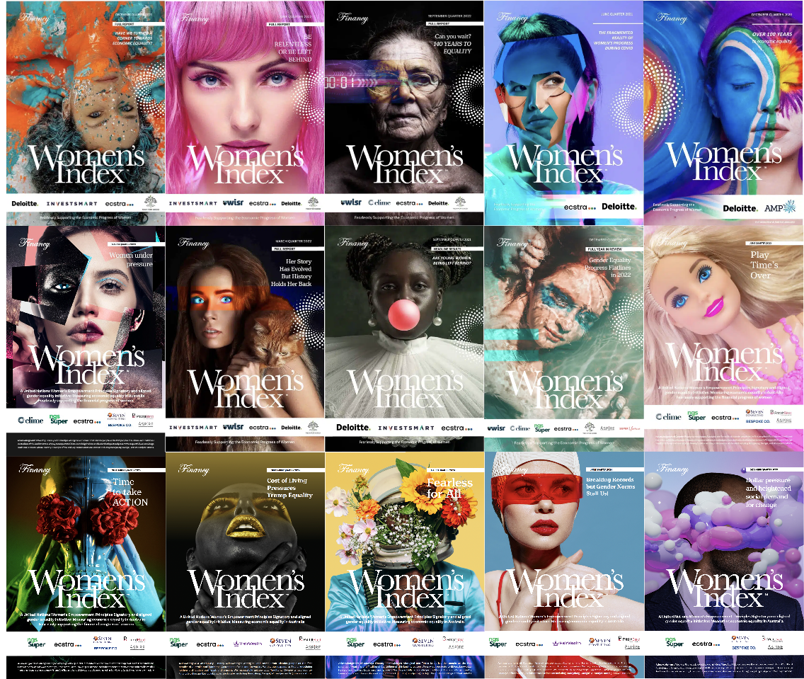
About Financy
8Million
Media Views per Year!
Financy is a social enterprise that for the past decade has been elevating gender equality discussion through the Women's Index.
Our vision is to create a future where gender inequality is no longer an issue and inclusivity is the greatest driver of innovation, wellbeing and prosperity.
To get there, our mission is to arm business leaders with the data, strategy, and communications to move from paralysis to progress, turning commitments into an authentic and compelling advantage.

Slide 4

Pathways to Activate on Gender Equity & Inclusion
Our Women's Index Membership is designed with two distinct paths
to create meaningful change:
Corporate Membership
For Corporate Leaders who must translate their gender equity and inclusion strategy into measurable, communicable results.
We provide the architecture for authentic progress
Consultant Membership
For Specialist Advisers who want to equip their clients with credible, data-driven solutions for gender equity and inclusion.
Your Experienced Activation Team Awaits

Slide 5









Corporate Membership:
Turn Data Into Communicable Action
Diagnose Your Culture
Validate Your Reputation
Full access to the IMPACTER™ platform to measure and track your organisation's gender equity progress and the critical employer/employee perception gaps
Brand placement in the Women's Index and digital badges to showcase your commitment and employee verified progress to gender, equity and inclusion.
Equip Your Team
Access a Peer Network
Ready-to-use toolkits to effectively communicate your progress internally and externally
Join exclusive webinars and events with other progressive leaders
Move from "the Plan" or what we call "data paralysis" to communicable progress
by connecting your internal reality with your external brand perception.

Slide 6



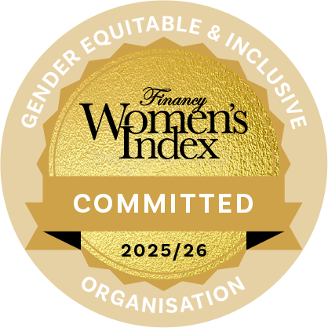
Corporate Membership Tiers
Women’s Index Silver Member
Annual Investment: $5,000
Digital Commitment Badge to recognise your Women’s Index Membership
Full IMPACTER™ platform access with 1:1 Onboarding & Goals Strategy Session
Earn your Digital IMPACTER Badge and become Employee Verified for your efforts
Brand placement in quarterly Women's Index
Industry-Specific Conversation Toolkit - demonstrate unique understanding and build trust
Women's Index Media Insights Report
Women’s Index Gold Member
Annual Investment: $10,000
All Partner Tier benefits plus:
Premier brand placement
WGEA Communications Guide & Manager's Talking Points
C-suite roundtable for senior leaders
C-suite thought leadership opportunities
$2,500 credit toward Culture Comms
Earn Your IMPACTER Badges & Promote Your Efforts!

Slide 7
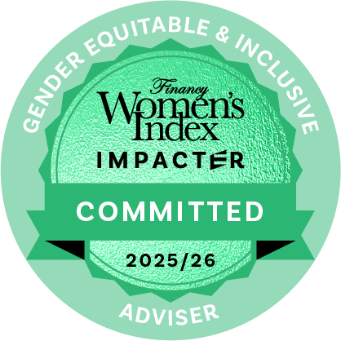
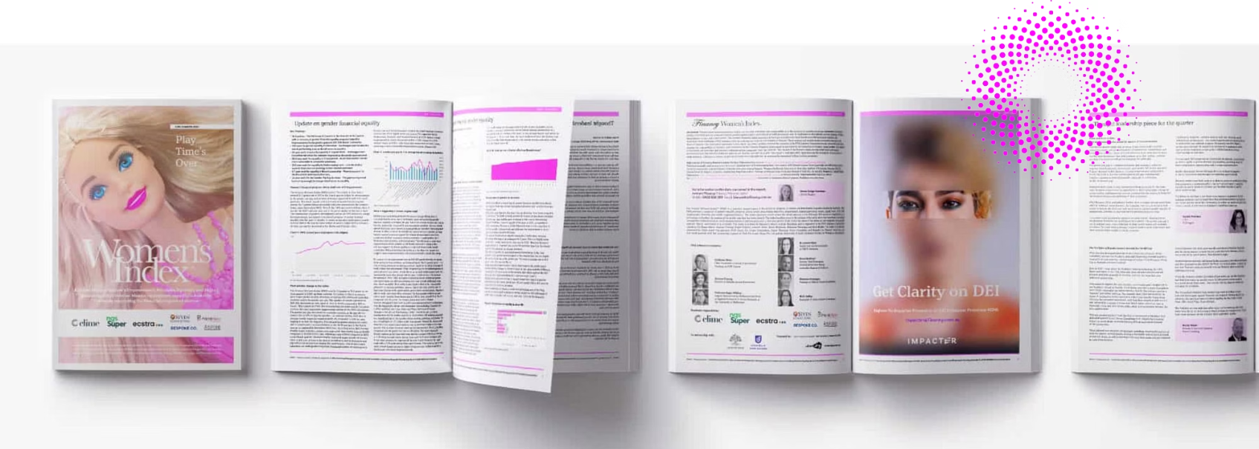

Consultant Membership
Certified Adviser
Annual Investment: $2,499
Full Multi-client access to IMPACTER™ platform
Digital "Commitment to Equality" badge
Brand placement in quarterly Women's Index
Network Directory for Lead Gen Amplification
Thought leadership opportunities
Opportunity to earn 10% on all IMPACTER + Culture Comms Client Referrals
Earn with us when Clients use IMPACTER

Slide 8
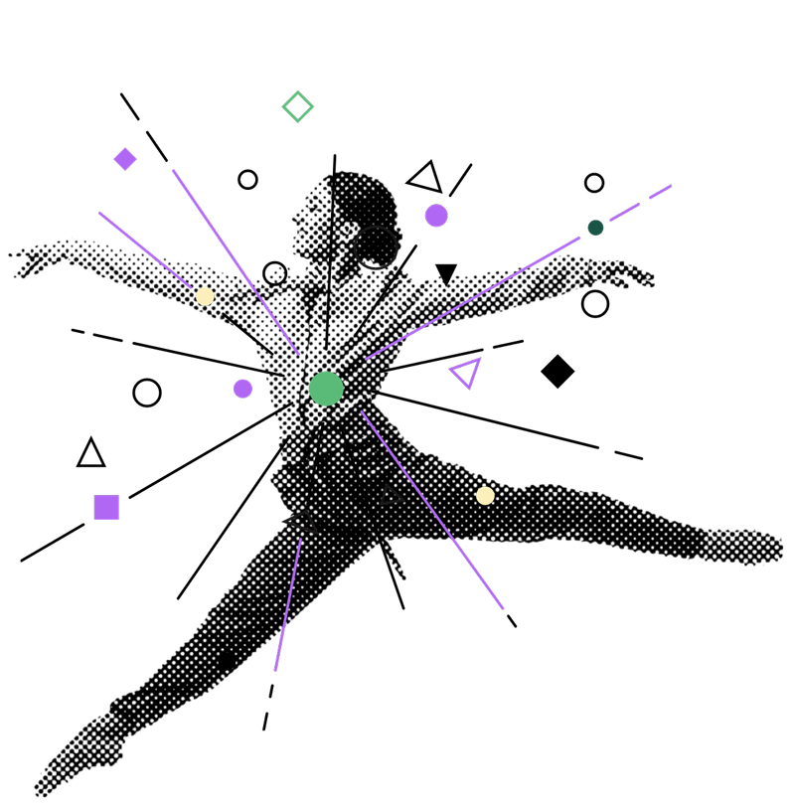
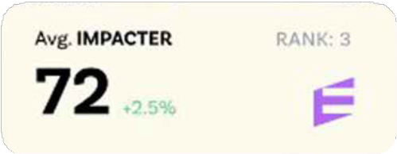
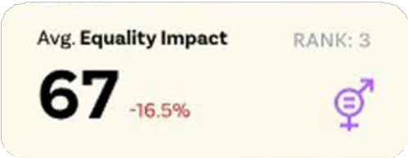
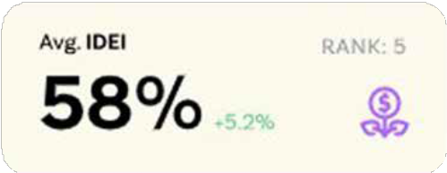
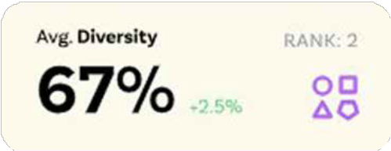
For Consultants:
Refer & Grow Your Practice
Leverage our established platform and reputation
to differentiate your consultancy and deliver
deeper value to your clients.
10%
10%
Referral Fee
Referral Fee
Earn on Culture Comms
program referrals
Earn recurring revenue for IMPACTER™ subscription referrals

Slide 9
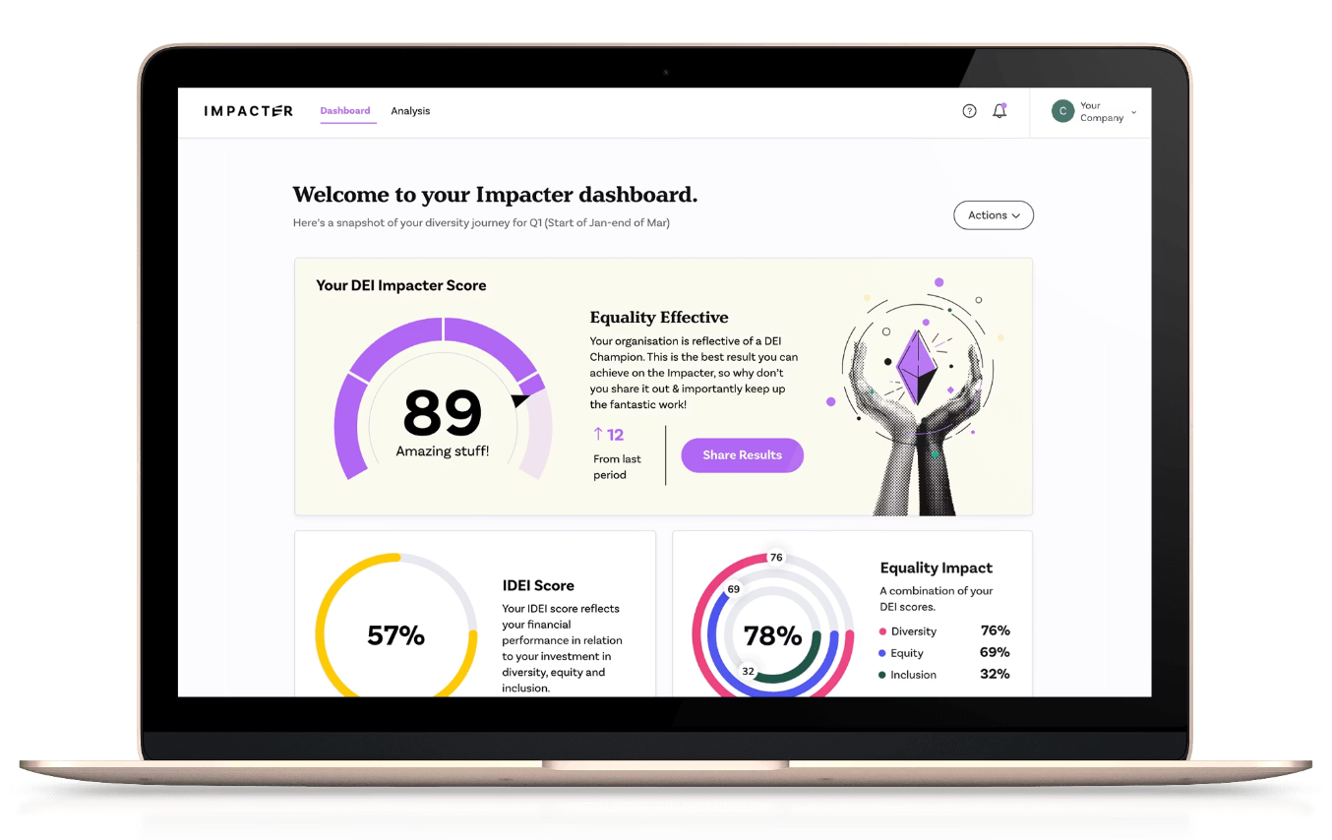

The IMPACTER™ Advantage
At the heart of both memberships is our proprietary IMPACTER™ platform, which transforms the way organisations measure and communicate gender equity progress. It also provides the critical data needed to respond to public WGEA requirements and activate commitments made through leadership groups like the Champions of Change Coalition.
Turns complex workforce data into actionable insights
Creates clear visualization of gender equity metrics
Benchmarks performance against industry statistics
Generates communication-ready reports for stakeholders
Tracks progress over time with quarterly updates
Data Secure. Fully compliant with Australian Privacy Laws and GDPR.

Slide 10
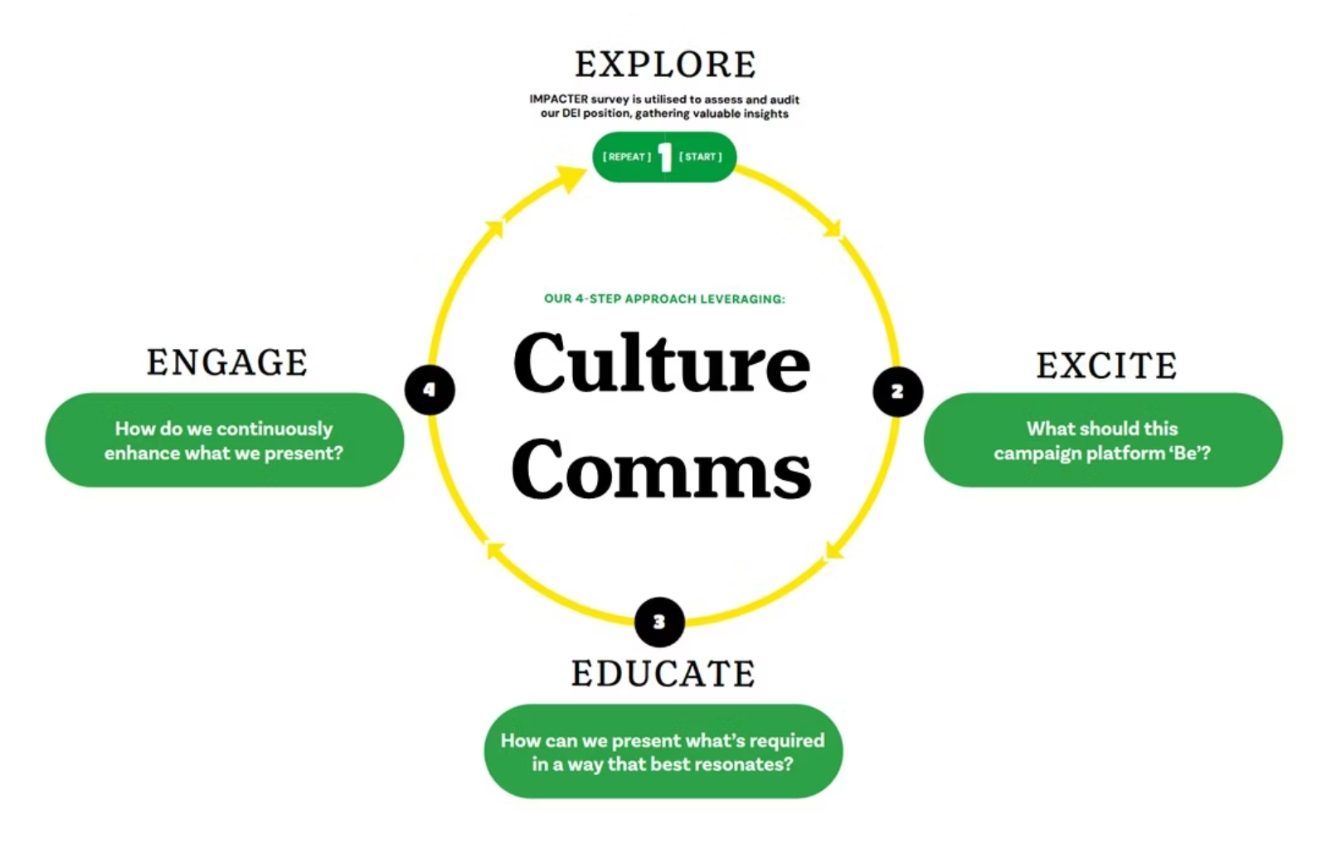

Culture Comms
Culture Comms is our unique consultancy approach that brings Gender Equity & Inclusion Data and Actions to life!
Leveraging data analysis & communications expertise, we take organisations on a journey that builds engagement, closes perception gaps and enhances brand image.
Culture Comms is powered by a critical partnership with Brand Strategy and Creative Communications Agency We Are Why. Financy is the architect who creates the data-driven blueprint for change, and We Are Why is the master builder who constructs the final, engaging communications campaign that brings it all to life.
Bianca and the team at Financy have been amazing to work with. We have successfully implemented the IMPACTER survey across our organisation and worked with the team on Culture Communications to help build on the foundational work we have down to ensure Bega Group is a more diverse, inclusive and equitable organisation for our team members, customers and community.
Jade Shillington, Manager - Diversity Equity and Inclusion

Slide 11


Become a
Women’s Index Member Today
Transform your commitment to gender equity & inclusion from aspiration to measurable action with Financy Membership.
Activate Your Organisation!
Grow Your Practice!
Questions? Contact our founder Bianca Hartge-Hazelman for a personalised consultation on which pathway is right for you: biancahh@financy.com.au or visit financy.com.au

Slide 12
Activate your Commitment!
www.wearewhy.com.au
www.financy.com.au

