Slide 1





Culture
Comms
Activate the Culture in your Organisation & Amplify with Authenticity
Copyright © 2025 FINANCY® Pty Ltd. The Financy Women’s Index™. All Rights Reserved.

Slide 2
A unique end-to-end solution that turns Gender Equity & Inclusion Data into Communicable Action
From Data Paralysis to Your Most Powerful Story.

Slide 3

The Leadership Disconnect
Your commitment to gender equity and inclusion is genuine. But does your team feel it? Does the market see it?
Too often, there's a gap between good intentions and authentic communication, leading to:
Data Paralysis & Inaction Risk
Employee Cynicism & Survey Fatigue
A Wasted Competitive Advantage

Slide 4

How Bega Group Activated Their Culture
Culture Transformation:
Bega Group engaged Financy to align its internal culture with its Diversity, Equity & Inclusion commitments. What followed was a Culture Communications Strategy and Creative Campaign platform, powered by We Are Why that translated complex performance data, goals, equity policies into clear, engaging content for all employees. This work has been critical to the inclusive culture being built at Bega.
Bianca and the team at Financy have been amazing to work with. We have successfully implemented the IMPACTER survey across our organisation and worked with the team on Culture Communications to help build on the foundational work we have down to ensure Bega Group is a more diverse, inclusive and equitable organisation for our team members, customers and community.
Jade Shillington, Manager - Diversity Equity and Inclusion

Slide 5



Our Point of Difference is key to our success
Experts in Data Analysis
We move beyond identifying problems to driving solutions and identifying opportunities
Communications Strategy
We design the Brand relevant Communications to educate and engage on key issues across various platforms and concepts.
Workplace Alignment
We connect and work to support key people across the workplace to ensure alignment on gender equity and inclusion goals
Engaged Creative
Communications campaigns that bring blueprints to life and ensure brand perception meets the reality.

Slide 6
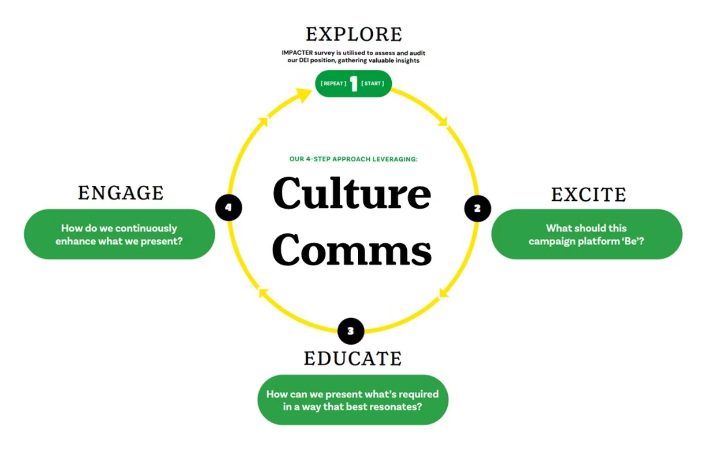

Our Approach: Culture Comms
Explore
A data-backed review of the client's current culture status, brand strategy, and commercial objectives.
Gather robust profile using IMPACTER platform and
other recommended tools.
Excite
Develop Creative Communications Campaign Concepts internal and external, build stakeholder anticipation of the journey and destination.
Educate
Deliver holistic Culture Comms roadmap that educates employees and key stakeholders.
Engage
Execute sustained Creative Comms with deployment of strategic assets inline with business goals.
A Tried & Tested Approach To Taking Action

Slide 7


Underpinning our Approach
Advisory
Accountability
Strategic advisory support for teams and leaders
Measure effectiveness of implemented strategies
Ongoing guidance to maintain momentum
Prove ROI with concrete metrics
Regular check-ins to address emerging challenges
Inform next strategic cycle with fresh insights
We’re Here To Support As An Extension Of Your Team

Slide 8




Culture Comms Outcomes
Data-Driven Strategy
Data backed roadmap for improved gender equity & inclusion performance
Authentic Brand Story
Comms Strategy to support the brand to attract and retain the best talent
Defensible Communications
Creative Campaigns and Templates to mitigate reputation risk
Actionable Reports & Assets
Translate culture investment into measurable performance

Slide 9

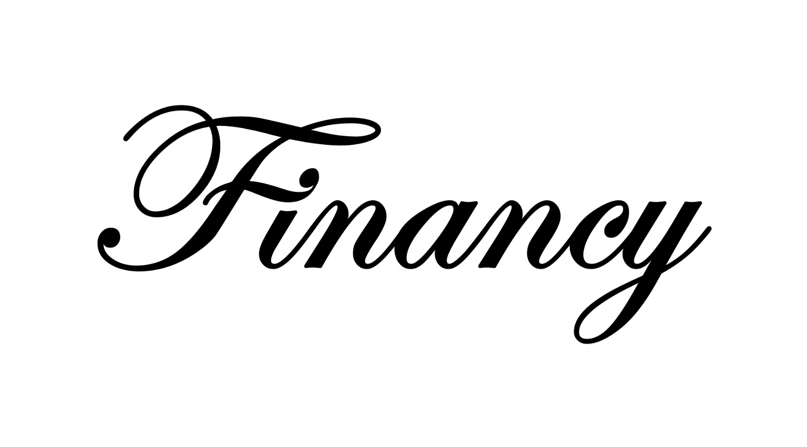






The Partnership Behind Culture Comms
Leaders in national gender equity timeframe data & communications
Masters of brand strategy and creative execution
Purpose-driven communications
Home to Financy Women's Index & IMPACTER tool
Align external promise with internal truth
Deep expertise in gender benchmarking and advising companies on strategy to progress
Creative storytelling & execution expertise

Slide 10

Executive Summary
Transform gender equity & inclusion data into strategic advantage
Six-phase proven methodology for measurable results
Balance internal culture with external brand perception
Comprehensive solution from analysis to implementation
Our Culture Comms approach delivers meaningful change while mitigating risks of inaction or inauthentic action.
Mitigate Risks & Deliver Meaningful Change

Slide 11

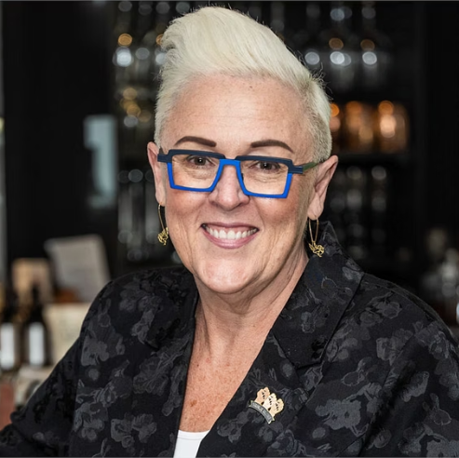


Success Stories:
Data Translation
We recently ran NGS Super’s performance through the IMPACTER to test how we’re pushing for more equity for our employees as well as the 115,000 Australians whose super savings we look after. On one hand, NGS outperformed benchmarks for diversity on our board,
as well as equity in gender diversity, pay reporting, parenting, types of leave, employment opportunities, and of course superannuation.
On the other hand, there is still space for us to continue to improve in terms of practices and strategies for improving equity overall.
Strategic Communication
As a workplace consultant with multiple companies using IMPACTER & Culture Comms, what I like about the solution is that it provides a comprehensive one-stop dashboard across all three critical areas of DEI and addresses what I currently see in organisations, which is fragmented data and a lot of manual intervention required to consolidate. The team then provide that missing link in Communications Strategic and activation which makes my job easier in bringing actions to life.
Culture Transformation
Netwealth engaged Financy to strategically amplify its culture vision whilst engaging key stakeholders and amplifying brand image. What followed was a Culture Communications Strategy and Creative Campaign platform that translated complex performance data into actionable insights to support organisational goals around culture and future talent acquisition and retention.
Enhancing Clarity & Consultancy & Culture

Slide 12
Your Pathway to Communicable Progress
Service
Cost for Org with 1,000 employees
Timeline
Phase 1: • Audit & Engagement
$15,000
4 weeks
Phase 2 : • Analysis & Strategy
Phase 3: • Plus Creative Concepts
$20,000-$30,000
  6-8 weeks
Phase 4: • Creative Activation
$25,000-$35,000+
4 weeks
Transform your workplace with a Culture Comms Approach

Slide 13


Ready to Move from Data Paralysis
to Authentic Performance?
Contact Information
Bianca Hartge-Hazelman
Culture Comms Lead
biancahh@financy.com.au
0403 656 399
Learn More
Websites:
www.financy.com.au
Bianca Hartge-Hazelman
Financy
Culture Comms Lead
Neil Hazelman
We Are Why
Culture Comms Creative Director
www.wearewhy.com.au
Your Experienced Activation Team Awaits

Slide 14
www.wearewhy.com.au
www.financy.com.au

